Slide 1
Chapter 4: Threads & Concurrency

Slide 2
Chapter 4: Threads
Overview
Multicore Programming
Multithreading Models
Thread Libraries
Implicit Threading
Threading Issues
Operating System Examples

Slide 3
Objectives
Identify the basic components of a thread, and contrast threads and processes
Describe the benefits and challenges of designng multithreaded applications
Illustrate different approaches to implicit threading including thread pools, fork-join, and Grand Central Dispatch
Describe how the Windows and Linux operating systems represent threads
Design multithreaded applications using the Pthreads, Java, and Windows threading APIs

Slide 4
Motivation
Most modern applications are multithreaded
Threads run within application
Multiple tasks with the application can be implemented by separate threads
  Update display
  Fetch data
  Spell checking
  Answer a network request
Process creation is heavy-weight while thread creation is light-weight
Can simplify code, increase efficiency
Kernels are generally multithreaded

Slide 5
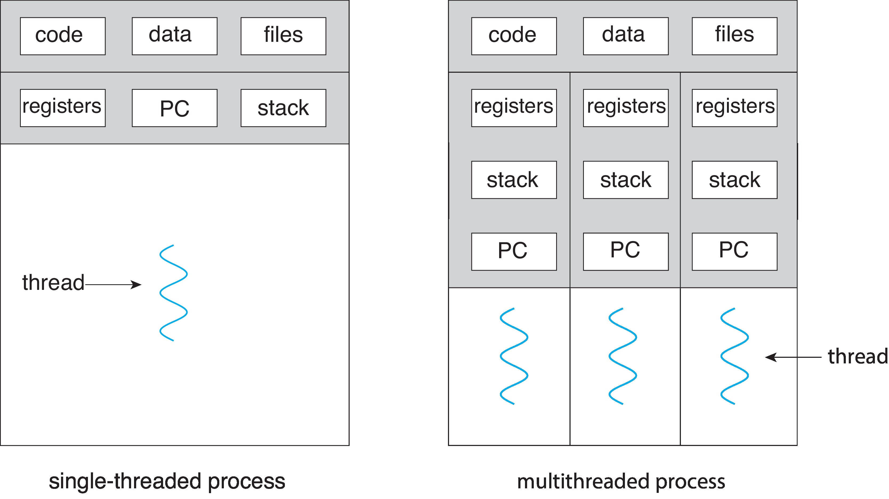
Single and Multithreaded Processes

Slide 6
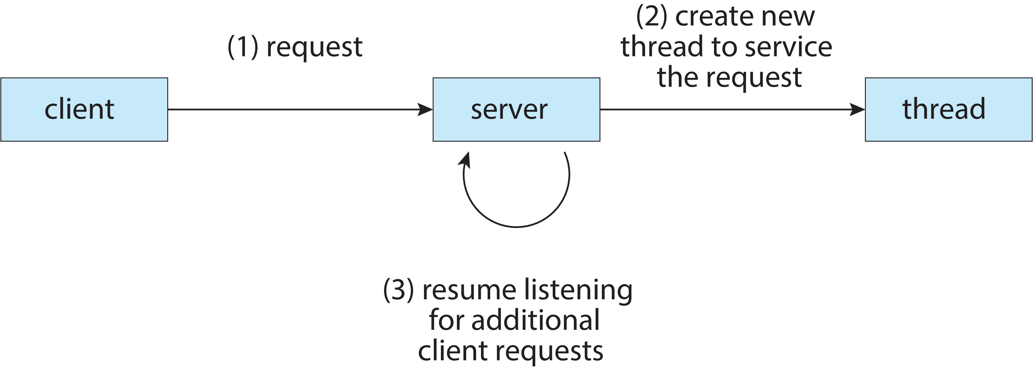
Multithreaded Server Architecture

Slide 7
Benefits
Responsiveness – may allow continued execution if part of process is blocked, especially important for user interfaces
Resource Sharing – threads share resources of process, easier than shared memory or message passing
Economy – cheaper than process creation, thread switching lower overhead than context switching
Scalability – process can take advantage of multicore architectures

Slide 8
Multicore Programming
Multicore or multiprocessor systems putting pressure on programmers, challenges include:
  Dividing activities
  Balance
  Data splitting
  Data dependency
  Testing and debugging
Parallelism implies a system can perform more than one task simultaneously
Concurrency supports more than one task making progress
  Single processor / core, scheduler providing concurrency

Slide 9
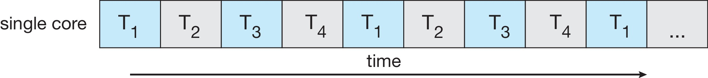
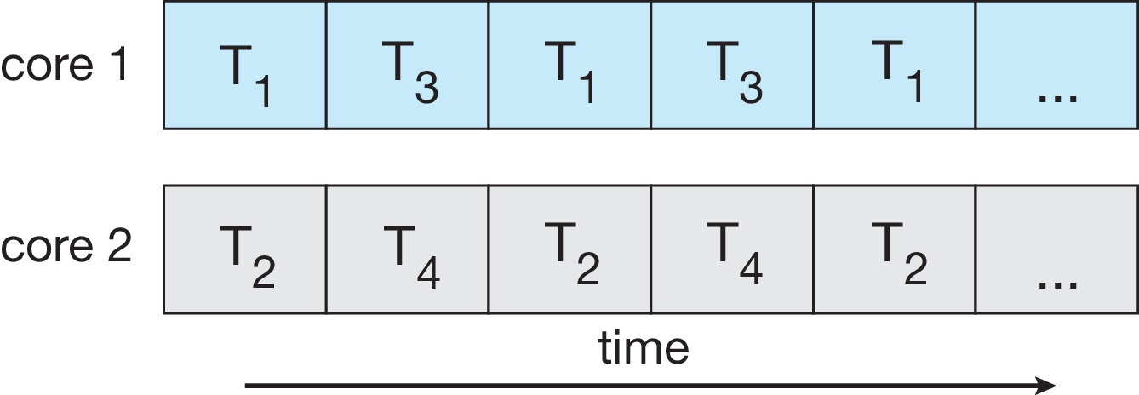
Concurrency vs. Parallelism
Concurrent execution on single-core system:
Parallelism on a multi-core system:

Slide 10
Multicore Programming
Types of parallelism
  Data parallelism – distributes subsets of the same data across multiple cores, same operation on each
  Task parallelism – distributing threads across cores, each thread performing unique operation

Slide 11
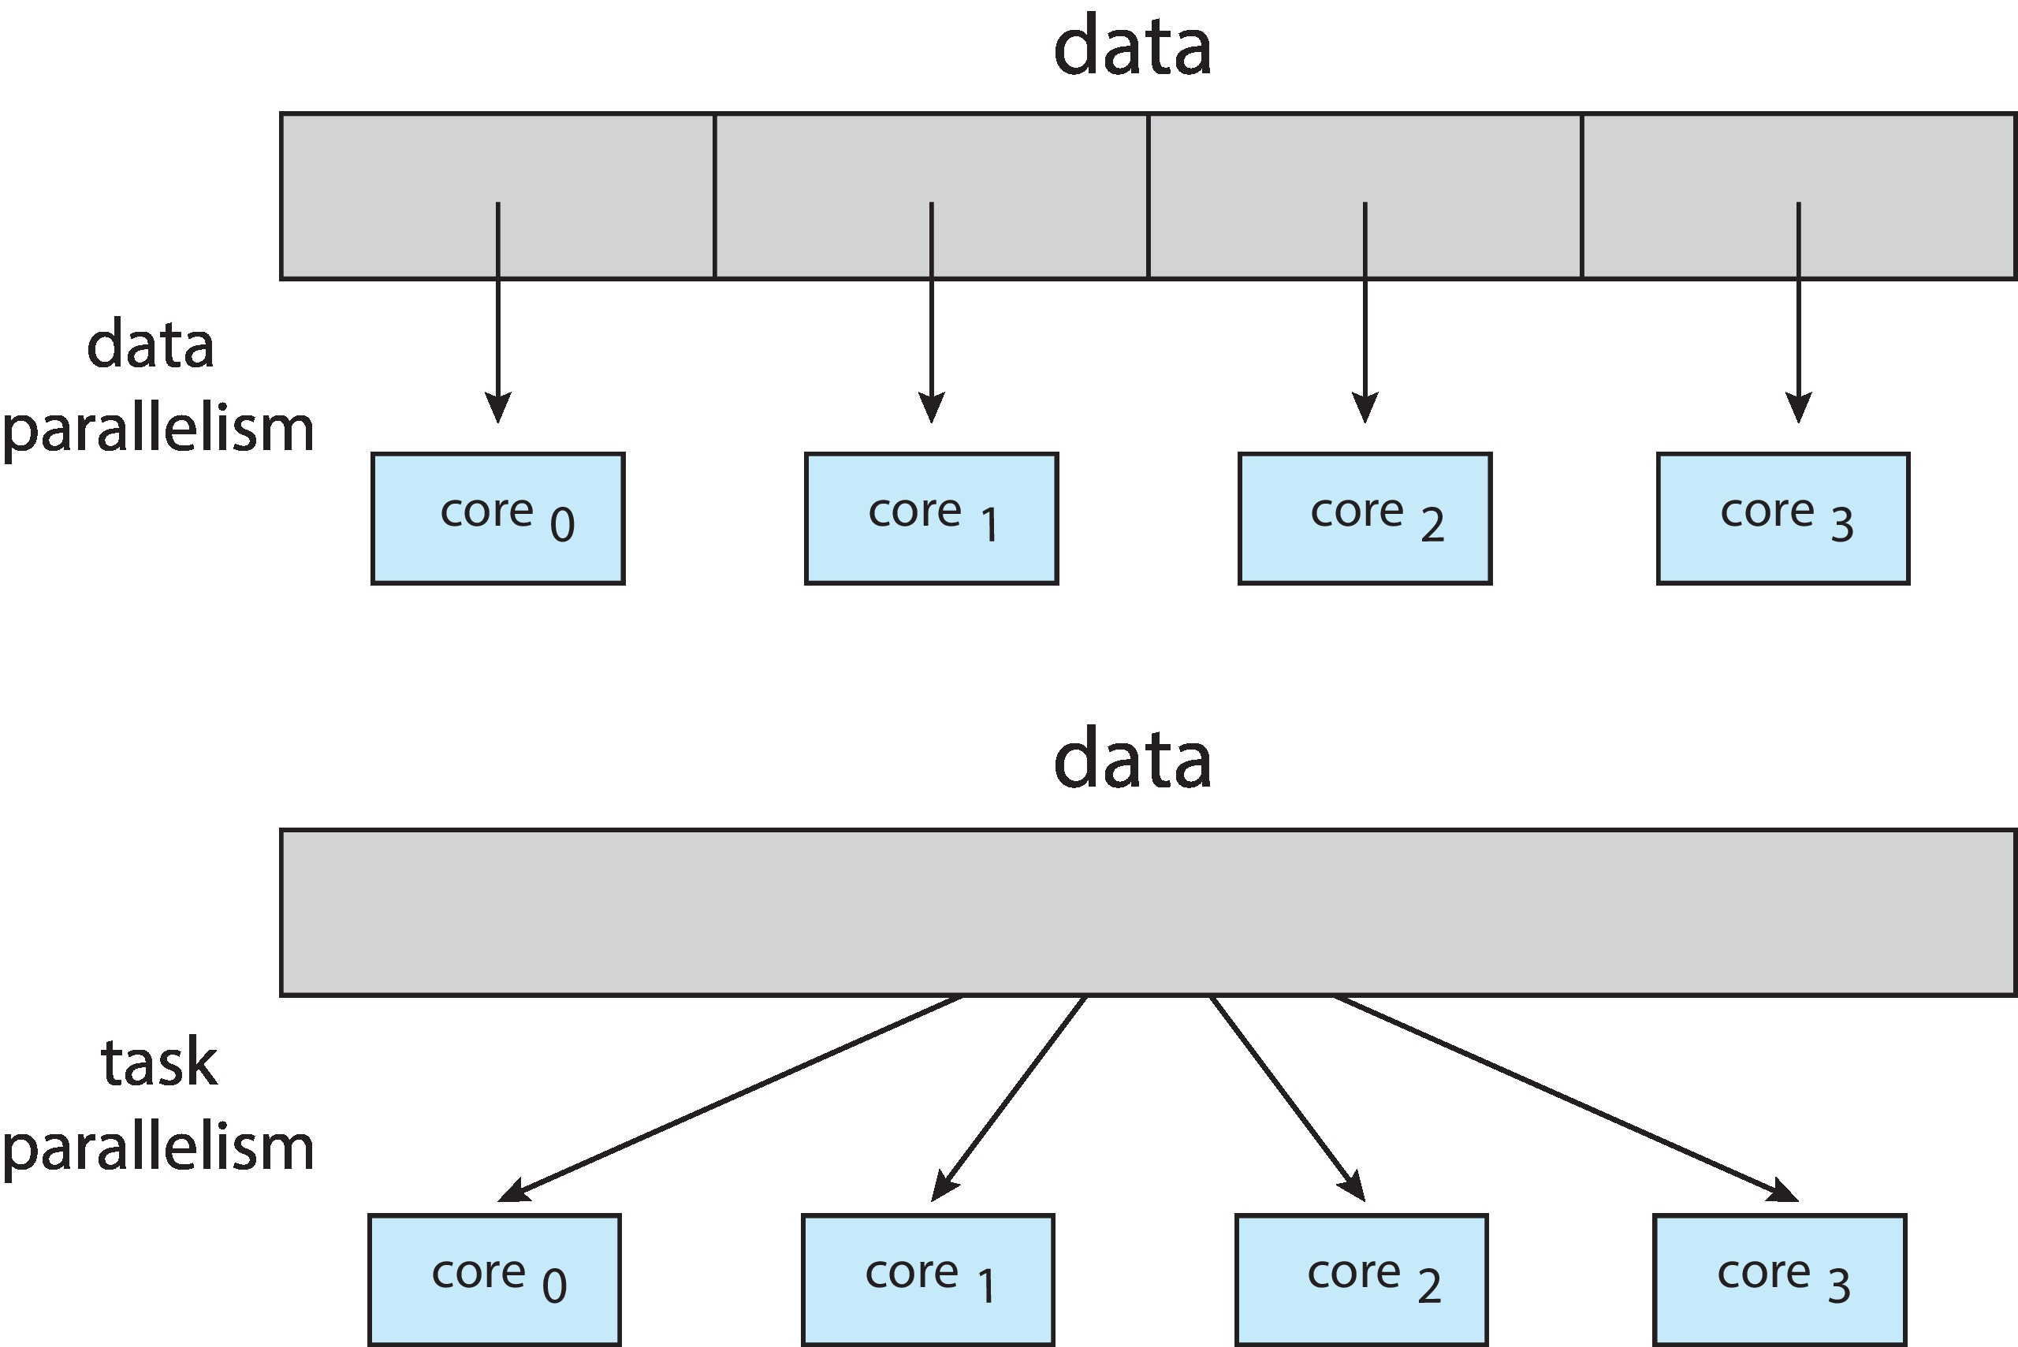
Data and Task Parallelism

Slide 12

Amdahl’s Law
Identifies performance gains from adding additional cores to an application that has both serial and parallel components
S is serial portion
N processing cores
That is, if application is 75% parallel / 25% serial, moving from 1 to 2 cores results in speedup of 1.6 times
As N approaches infinity, speedup approaches 1 / S
Serial portion of an application has disproportionate effect on performance gained by adding additional cores
But does the law take into account contemporary multicore systems?

Slide 13
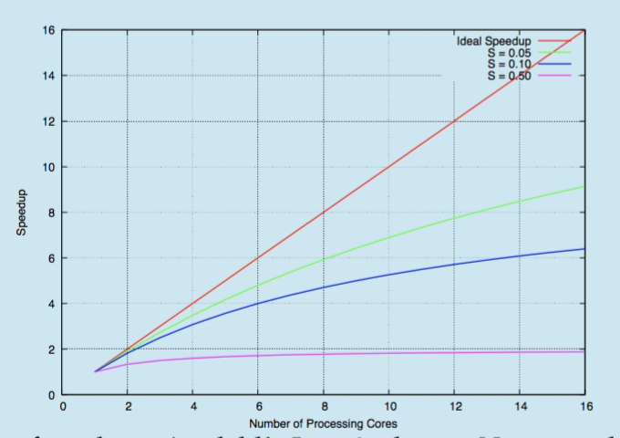
Amdahl’s Law

Slide 14
User Threads and Kernel Threads
User threads - management done by user-level threads library
Three primary thread libraries:
  POSIX Pthreads
  Windows threads
  Java threads
Kernel threads - Supported by the Kernel
Examples – virtually all general purpose operating systems, including:
  Windows
  Linux
  Mac OS X
  iOS
  Android

Slide 15
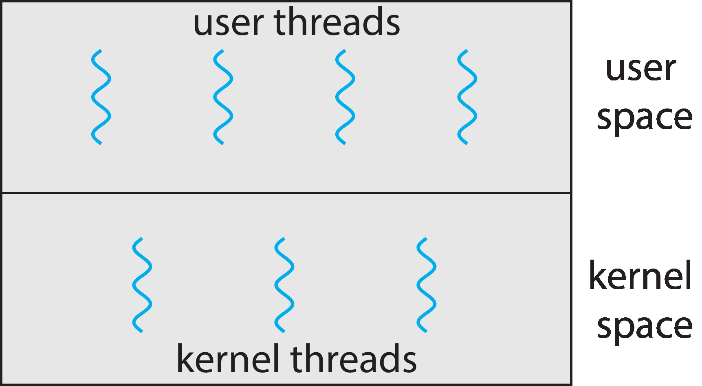
User and Kernel Threads

Slide 16
End (Week4)

Slide 17
Week-5

Slide 18
Multithreading Models
Many-to-One
One-to-One
Many-to-Many

Slide 19
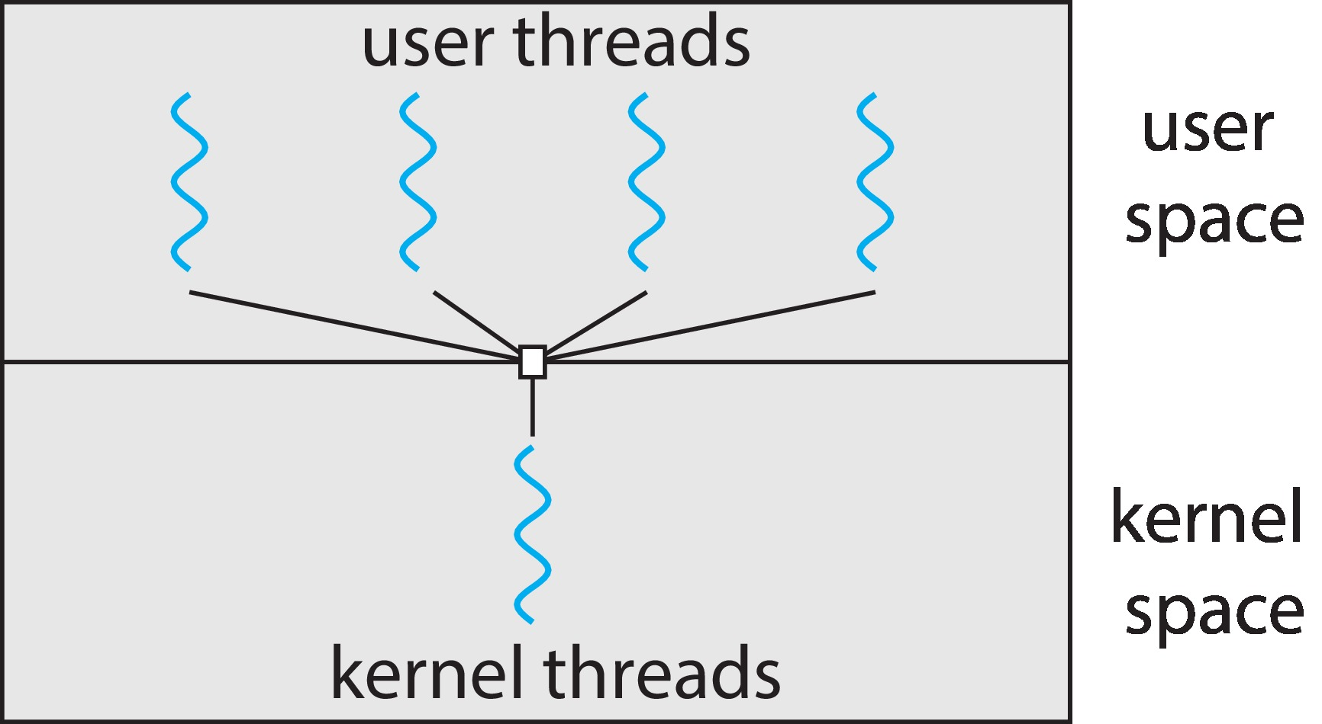
Many-to-One
Many user-level threads mapped to single kernel thread
One thread blocking causes all to block
Multiple threads may not run in parallel on muticore system because only one may be in kernel at a time
Few systems currently use this model
Examples:
  Solaris Green Threads
  GNU Portable Threads

Slide 20
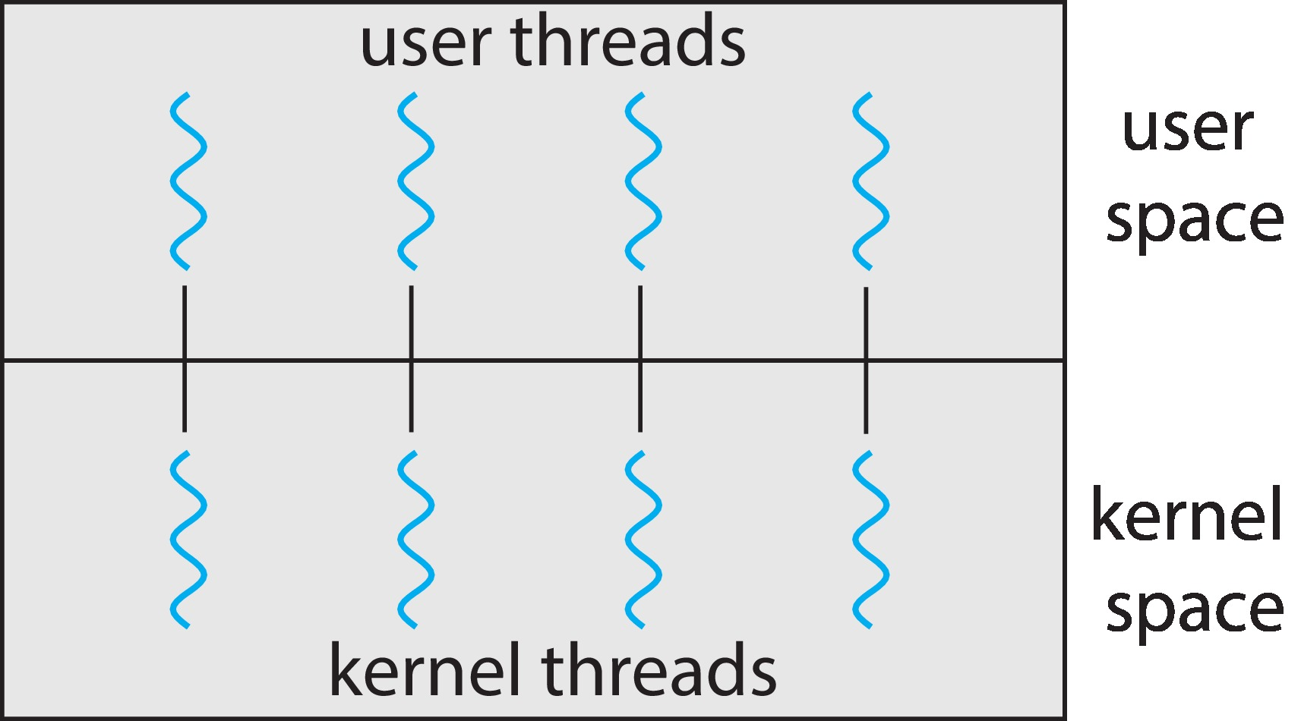
One-to-One
Each user-level thread maps to kernel thread
Creating a user-level thread creates a kernel thread
More concurrency than many-to-one
Number of threads per process sometimes restricted due to overhead
Examples
  Windows
  Linux

Slide 21
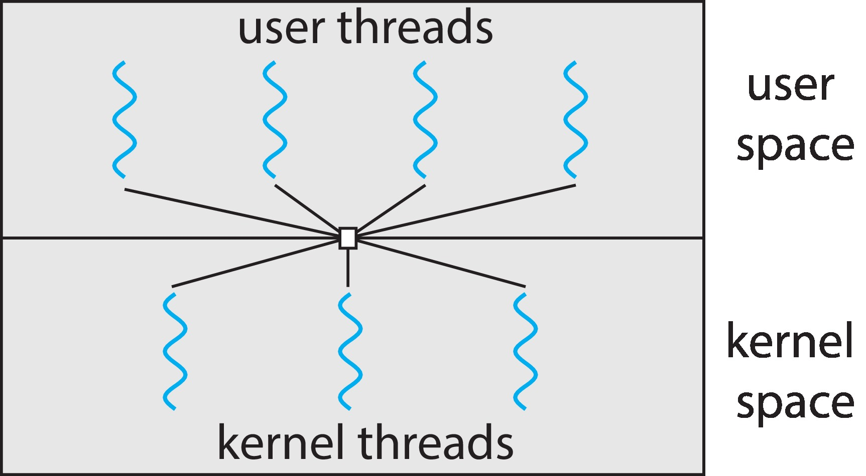
Many-to-Many Model
Allows many user level threads to be mapped to many kernel threads
Allows the operating system to create a sufficient number of kernel threads
Windows with the ThreadFiber package
Otherwise not very common

Slide 22
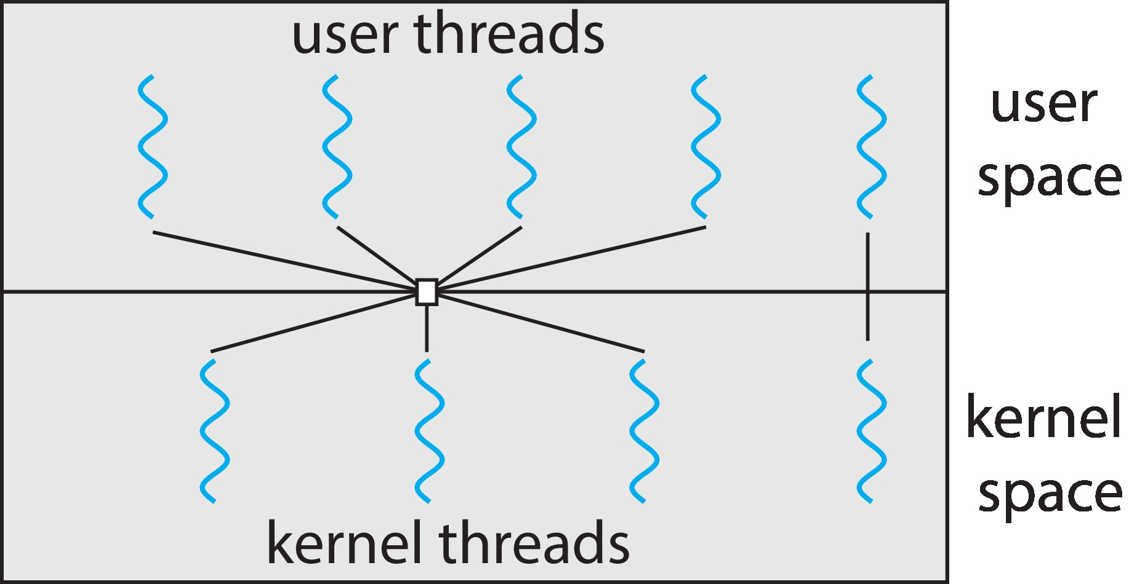
Two-level Model
Similar to M:M, except that it allows a user thread to be bound to kernel thread

Slide 23
Thread Libraries
Thread library provides programmer with API for creating and managing threads
Two primary ways of implementing
  Library entirely in user space
  Kernel-level library supported by the OS

Slide 24
Pthreads
May be provided either as user-level or kernel-level
A POSIX standard (IEEE 1003.1c) API for thread creation and synchronization
Specification, not implementation
API specifies behavior of the thread library, implementation is up to development of the library
Common in UNIX operating systems (Linux & Mac OS X)

Slide 25
Threading Issues
Semantics of fork() and exec() system calls
Signal handling
  Synchronous and asynchronous
Thread cancellation of target thread
  Asynchronous or deferred
Thread-local storage
Scheduler Activations

Slide 26
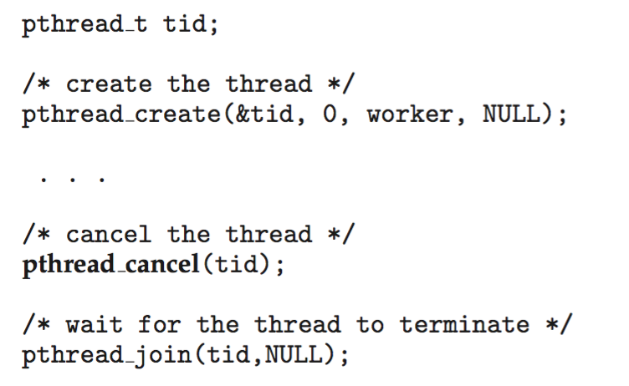
Thread Cancellation
Terminating a thread before it has finished
Thread to be canceled is target thread
Two general approaches:
  Asynchronous cancellation terminates the target thread immediately
  Deferred cancellation allows the target thread to periodically check if it should be cancelled
Pthread code to create and cancel a thread:

Slide 27
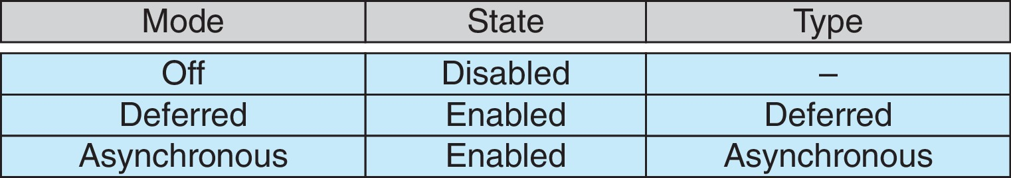
Thread Cancellation (Cont.)
Invoking thread cancellation requests cancellation, but actual cancellation depends on thread state
If thread has cancellation disabled, cancellation remains pending until thread enables it
Default type is deferred
  Cancellation only occurs when thread reaches cancellation point
    I.e. pthread_testcancel()
    Then cleanup handler is invoked
On Linux systems, thread cancellation is handled through signals

Slide 28
Operating System Examples
Windows Threads
Linux Threads

Slide 29
Windows Threads
Windows API – primary API for Windows applications
Implements the one-to-one mapping, kernel-level
Each thread contains
  A thread id
  Register set representing state of processor
  Separate user and kernel stacks for when thread runs in user mode or kernel mode
  Private data storage area used by run-time libraries and dynamic link libraries (DLLs)
The register set, stacks, and private storage area are known as the context of the thread

Slide 30
Windows Threads (Cont.)
The primary data structures of a thread include:
  ETHREAD (executive thread block) – includes pointer to process to which thread belongs and to KTHREAD, in kernel space
  KTHREAD (kernel thread block) – scheduling and synchronization info, kernel-mode stack, pointer to TEB, in kernel space
  TEB (thread environment block) – thread id, user-mode stack, thread-local storage, in user space

Slide 31
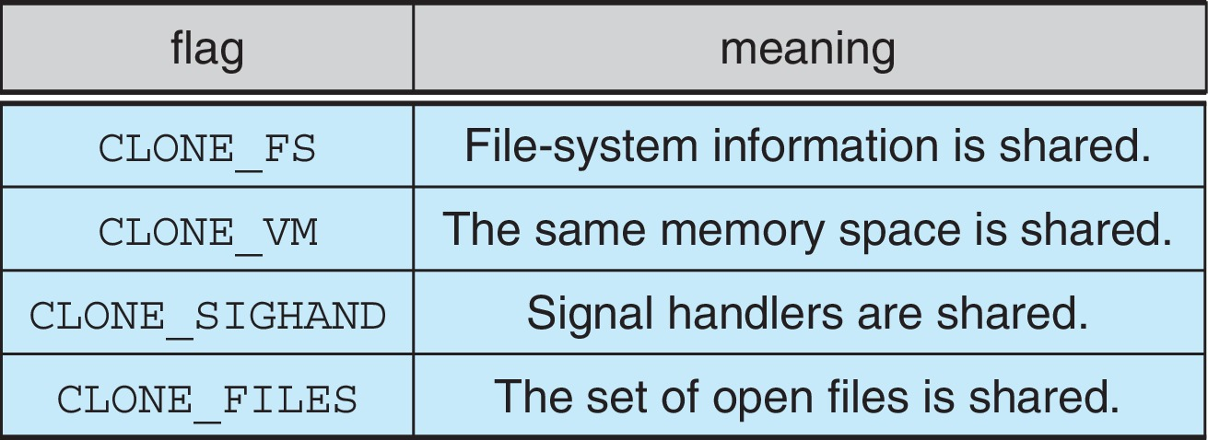
Linux Threads
Linux refers to them as tasks rather than threads
Thread creation is done through clone() system call
clone() allows a child task to share the address space of the parent task (process)
  Flags control behavior
struct task_struct points to process data structures (shared or unique)

Slide 32
End of Chapter 4

